Slide 1
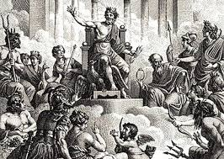
Greco Roman gods

Slide 2
Zeus
Roman name: Jupiter
God of the sky and weather, king of the gods
Symbols: oak, thunderbolt, bull, eagle
Parents: Cronus and Rhea

Slide 3
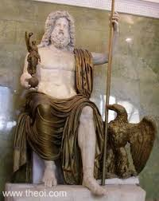
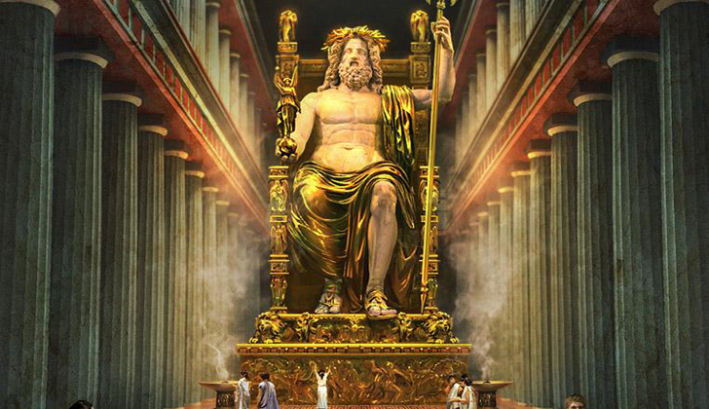
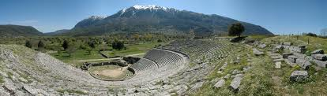
Zeus

Slide 4
Poseidon
Roman name: Neptune
God of the sea, earthquakes, storms, and horses
Symbols: horses, trident
Parents: Cronos and Rhea

Slide 5
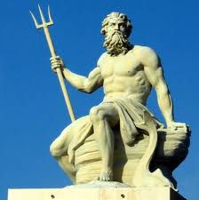
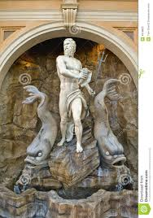
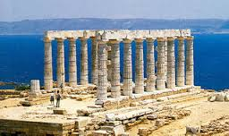
Poseidon

Slide 6
Hades
Roman name: Pluto, Dis
God of the underworld and wealth
Symbols: bident, Cerberus, cap of invisibility
Parents: Cronos and Rhea

Slide 7

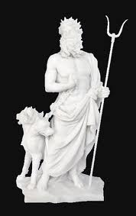
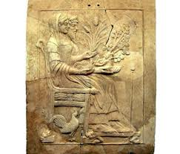
Hades

Slide 8
Hestia
Roman name: Vesta
Goddess of hearth and home
Symbols: fire and hearth
Parents: Cronos and Rhea

Slide 9
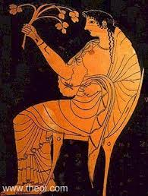
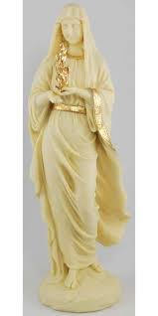
Hestia

Slide 10
Demeter
Roman name: Ceres
Goddess of agriculture
Symbols: cornucopia, wheat, torch, bread
Parents: Cronos and Rhea

Slide 11
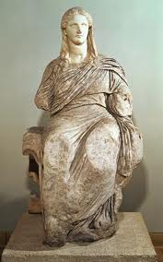
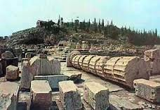
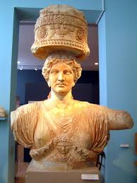
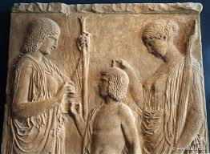
Demeter

Slide 12
Hera
Roman name: Juno
Goddess of marriage and childbirth
Symbols: peacock, cuckoo
Parents: Cronos and Rhea

Slide 13

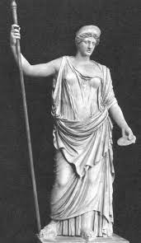
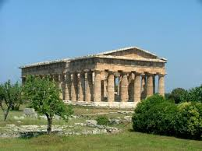
Hera

Slide 14
Athena
Roman name: Minerva
Goddess of war, wisdom, and weaving
Symbols: owl, aegis, spear
Parent: Zeus

Slide 15
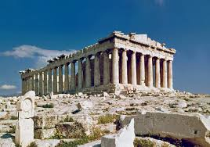
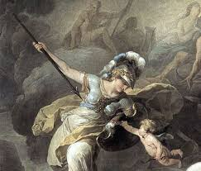
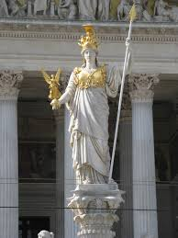
Athena

Slide 16
Ares
Roman name: Mars
God of war
Symbols: dogs, vultures, sword
Parents: Zeus and Hera

Slide 17
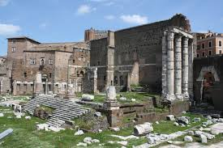
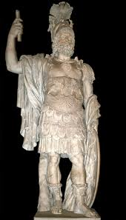
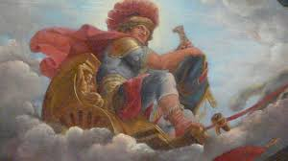
Ares

Slide 18
Hephaestus
Roman name: Vulcan
God of fire and metalworking
Symbols: fire, anvil, forge
Parent: Hera

Slide 19
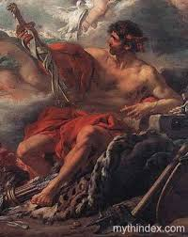
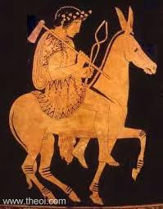
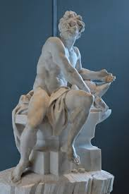
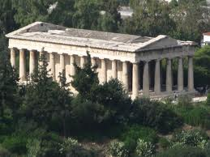
Hephaestus

Slide 20
Apollo
Roman name: Apollo
God of the sun, music, light, and prophecy
Symbols: Sun, bow and arrows, lyre
Parents: Zeus and Leto

Slide 21
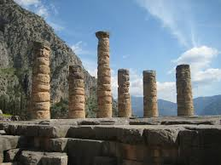
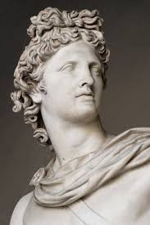
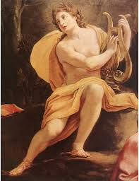
Apollo

Slide 22
Artemis
Roman name: Diana
Goddess of the moon, childbirth, and wild things
Symbols: moon, deer, bows and arrows
Parents: Zeus and Leto

Slide 23
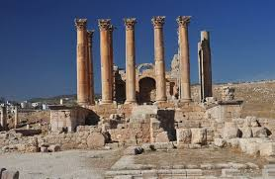
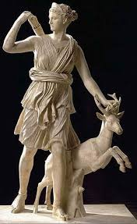
Artemis

Slide 24
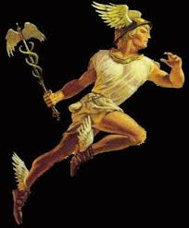
Hermes
Roman name: Mercury
God of merchants, travelers, and thieves
Parents: Zeus and Maia

Slide 25
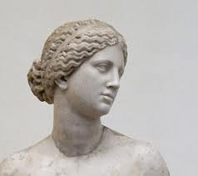
Aphrodite
Roman name: Venus
Goddess of love and beauty
Born from sea foam

Slide 26
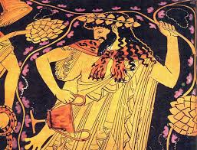
Dionysus
Roman name: Bacchus or Liber
God of wine, revelry, and theater
Parents: Zeus and Semele

